Slide 1
EMPLOYEE RESEARCH PROGRESS MANAGEMENT SYSTEM
DBMS J COMPONENT FINAL REVIEW
CSE2004
TEAM MEMBERS-
T.RAHUL REDDY 19BCE1778
VINEETH VICTOR 19BCE1792

Slide 2
1.Objective(s) of the proposed work
This project contains two different portals. One for the students and other for the faculties.
The faculty portal contains is secured with the login ID and a password. Every faculty can update the status of their research like the research in particular files is completed or still in progress. If the research is completed, he can upload all the details of the research paper and the publications.
The student’s portal is the access that is made available for the students to get the research details of the faculty available in the college according to their areas of the interest. The students can download the research details and also register under the faculty.

Slide 3
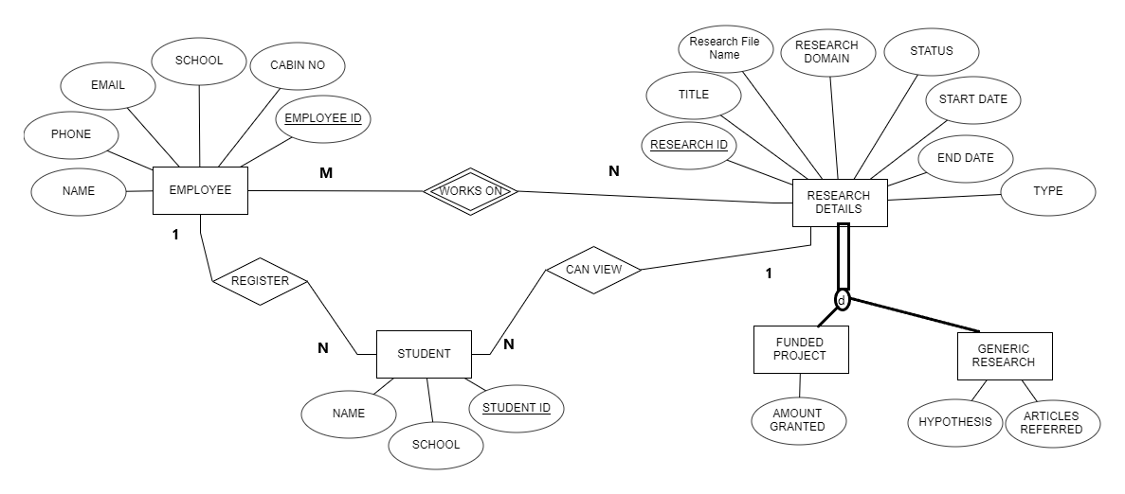
ER DIAGRAM

Slide 4
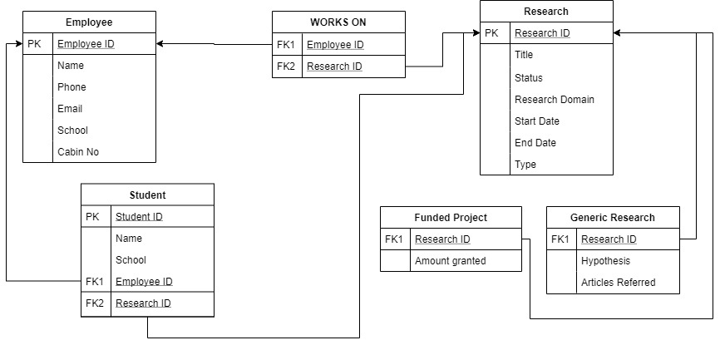
RELATIONAL SCHEMA

Slide 5
MODULES
MODULE-1:Employee login
Purpose: To maintain the security, integrity and privacy of the database.
Input: Username, Unique Employee ID, Password
Processing: When an employee enters his/ her unique employee ID, along with the username and password, it processes to their personal account.
Output: Displays the employees personal and research details.
MODULE-2:Employee sign-up
Purpose: It is helpful the new users who aren’t existing in this management system.
Input: Name, Password, Retype password and Personal Details.
Processing: Creates a new row in the database for every new employee.
Output: New login credentials for that employee will be created.

Slide 6
MODULE-3:Adding a new research
Purpose: Helps every employee to maintain the research work up-to-date.
Input: Type of Research, Research ID, Status of the research, Research title, Start date, End date
Processing: A new row is created in the research details database.
Output: Displays the research details of the new project
MODULE-4:Edit/ updating the research progress
Purpose: Its helps to change according to the employee state of mind.
Input: The details which are to be updated.
Processing: None
Output: Displays the clear output of the updated progress and research details.

Slide 7
MODULE-5:Uploading the research papers
Purpose: Employees can upload their research files with the help of a Research ID and can help students to get a clear picture about the project they would like to work on.
Input: Files that has to be uploaded
Processing: The uploaded file is moved and the file name is also updated in the SQL table
Output: Research paper is Uploaded
MODULE-6:Downloading the research papers
Purpose: Students and Employees can download their research files with the help of a Research ID and this can help students where they can download the respective files uploaded by the faculty
Input: None
Processing: A download link would be made available
Output: Research paper is downloaded

Slide 8
MODULE-7:Displaying the students that have registered under the faculty
Purpose: Employees can view the student details that have registered under them and it also displays under which project they have registered.
Input: None
Processing: The data is fetched from the SQL database
Output: No of students who have registered under a faculty is being Displayed
MODULE-8:Displaying the employee’s personal and research details
Purpose: Employees can view their personal and research details
Input: None
Processing: The data is fetched from the SQL database with the help of their respective employee ID and research ID
Output: Displays faculty’s personal and research details.

Slide 9
MODULE-9:Student Login
Purpose: To maintain the security, integrity and privacy of the database.
Input: Username (unique student ID), Password
Processing: When an student enters his/ her unique employee ID, along with the password, it processes to their personal account.
Output: Displays the student personal and faculty’s research details.
MODULE-10:Student Sign-Up
Purpose: It is helpful the new users who aren’t existing in this management system.
Input: Name, Password, Retype password and Personal Details.
Processing: Creates a new row in the database for every new student.
Output: New login credentials for that student will be created.

Slide 10
MODULE-11:Student’s Personal Details and Faculty Details they have registered under
Purpose: Students can view their personal details like their Student ID, Name and School and they can also view their faculty details such as faculty’s name and project they have registered under
Input: None
Processing: None
Output: Personal details and the faculty details are displayed
MODULE-12:Student’s Registration under a faculty
Purpose: Interested student can register under the employee’s project and work under their supervision
Input: Students can register under the faculty with any hassle
Processing: None
Output: Displays that the student is registered under the faculty

Slide 11
SOFTWARE USED
FRONT-END(CLIENT-SIDE)
HTML
CSS
BOOTSTRAP 4
BACK-END(SERVER-SIDE)
SQL
PHP
JAVASCIRPT
XAMPP WEB SERVER IS USED TO CONNECT FRONT-END AND BACK-END

Slide 12
SNAPSHOTS ALONG WITH VALIDATION

Slide 13
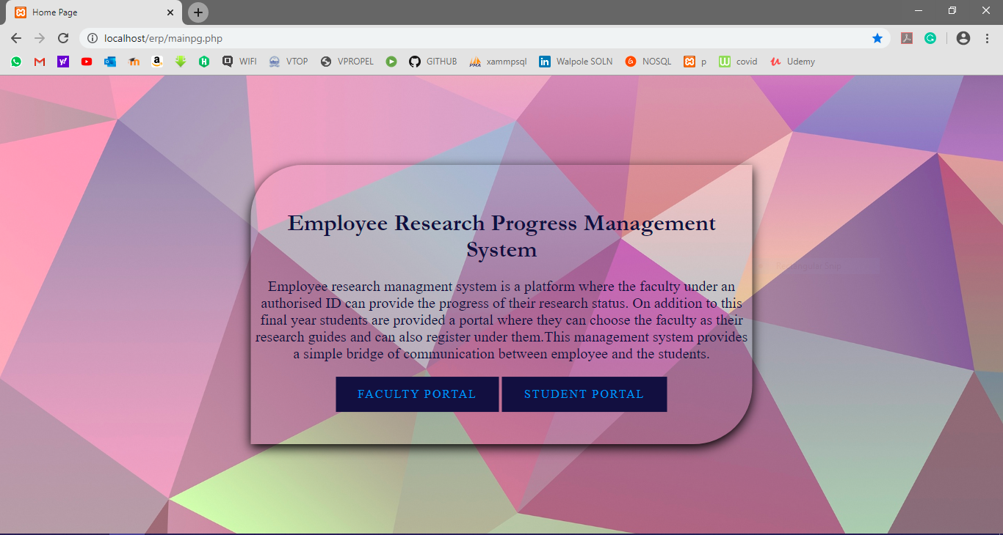
Project Main Page

Slide 14
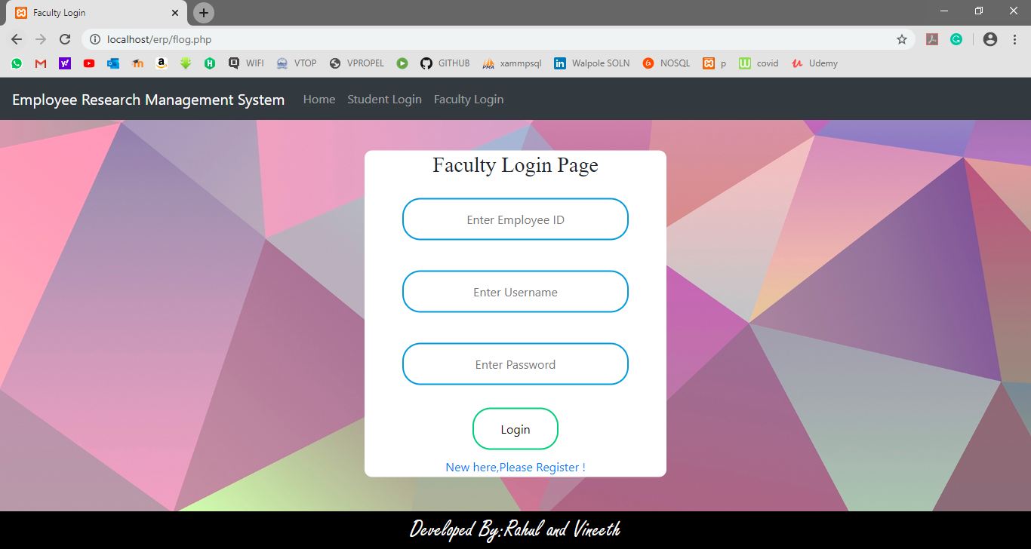
FACULTY PORTAL- Login Page

Slide 15
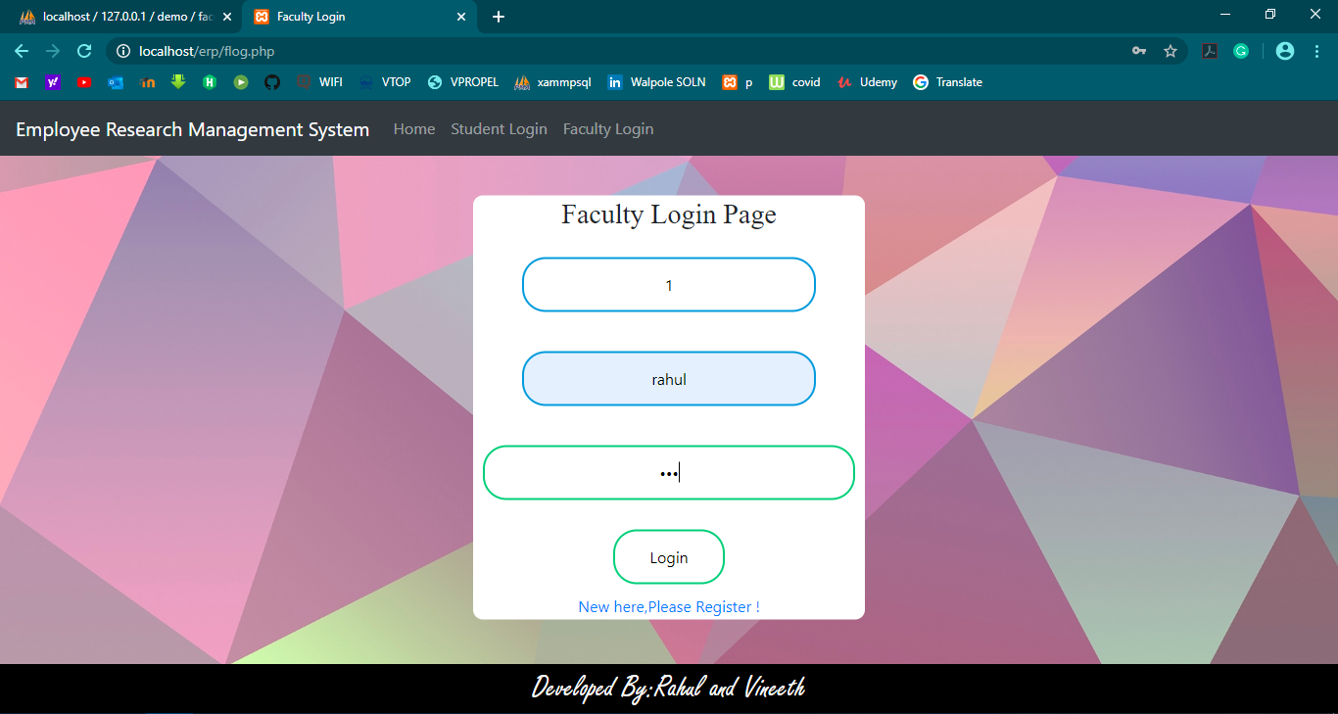
FACULTY PORTAL- Login Page

Slide 16
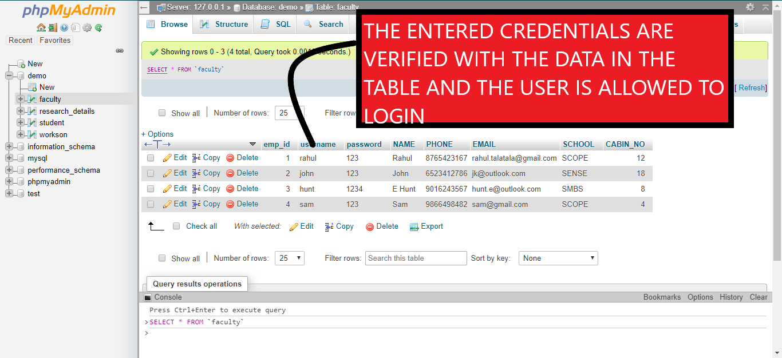
FACULTY PORTAL- Login Page Validation

Slide 17
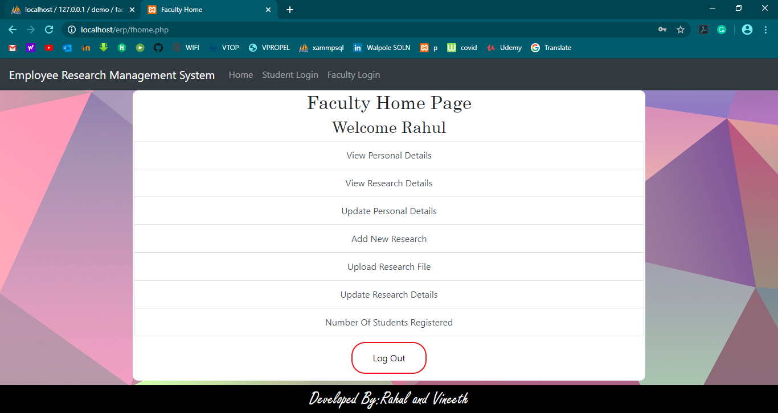
FACULTY PORTAL- Home Page

Slide 18
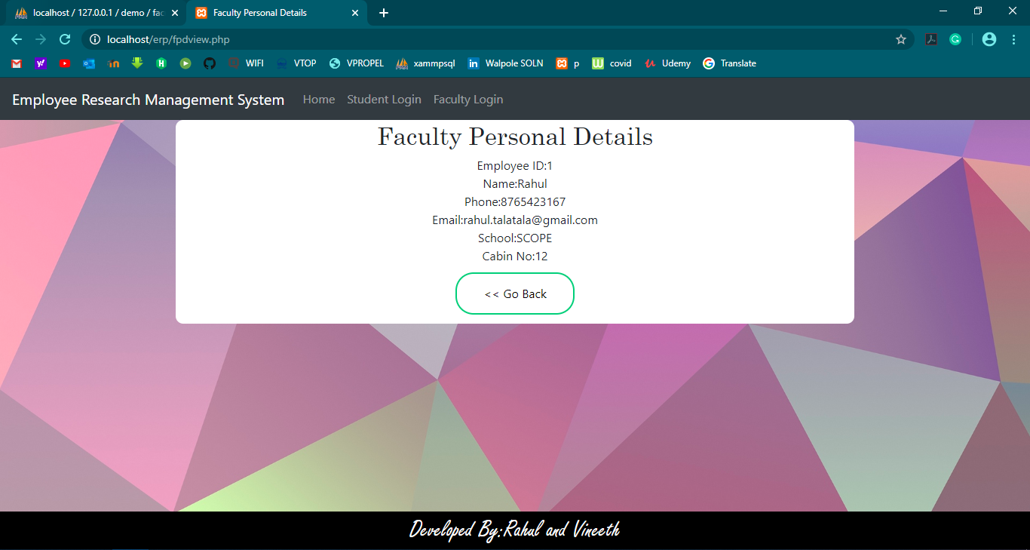
FACULTY PORTAL-Personal Details Page

Slide 19
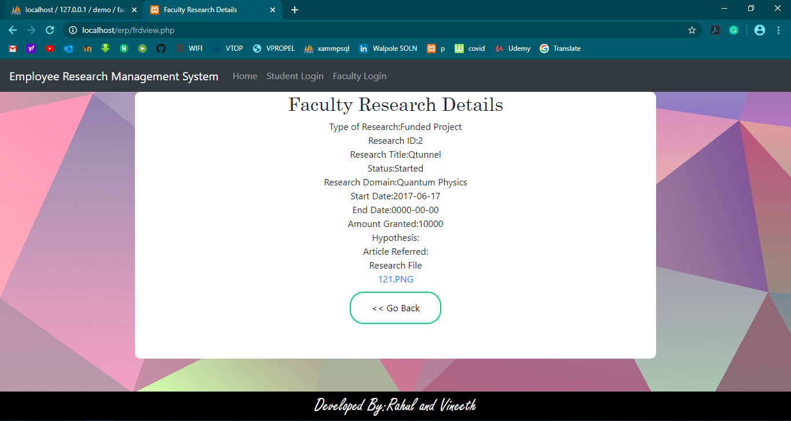
FACULTY PORTAL-Research Details Page

Slide 20
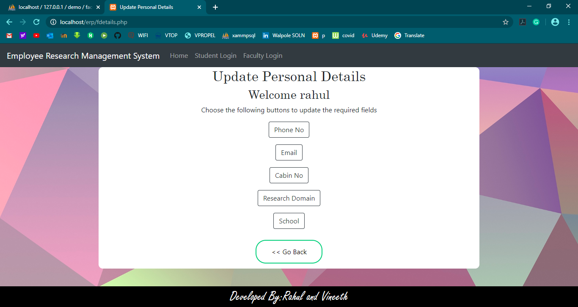
FACULTY PORTAL-Update Personal Details Page

Slide 21
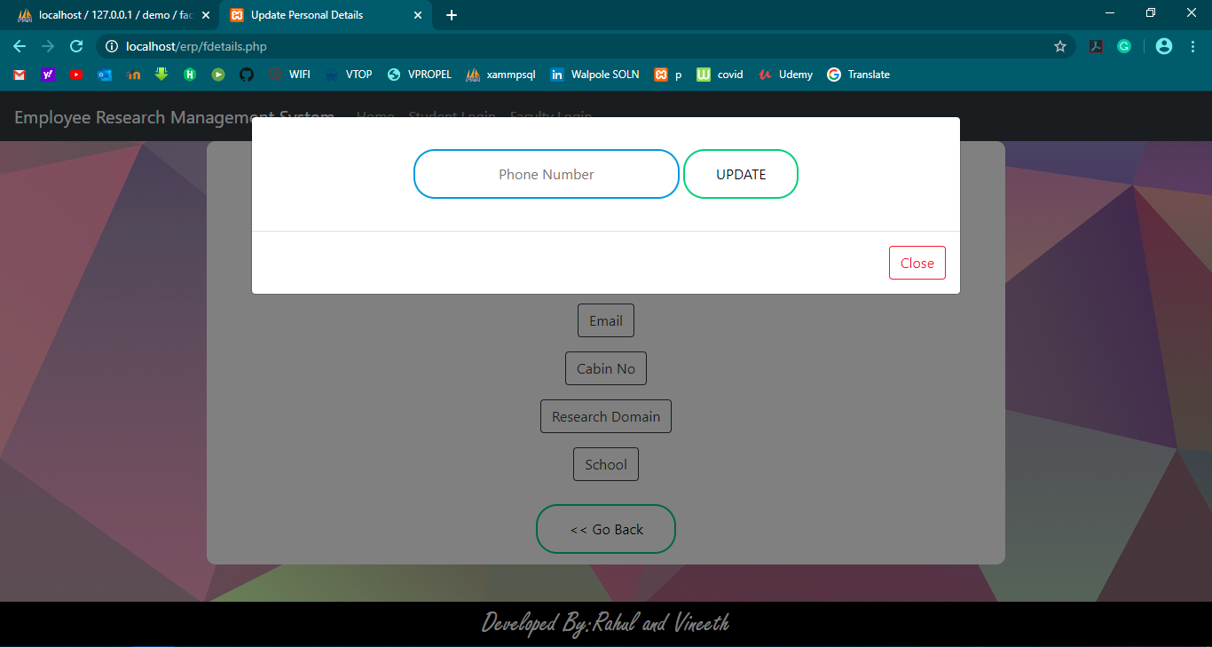
FACULTY PORTAL-Update Personal Details Page

Slide 22
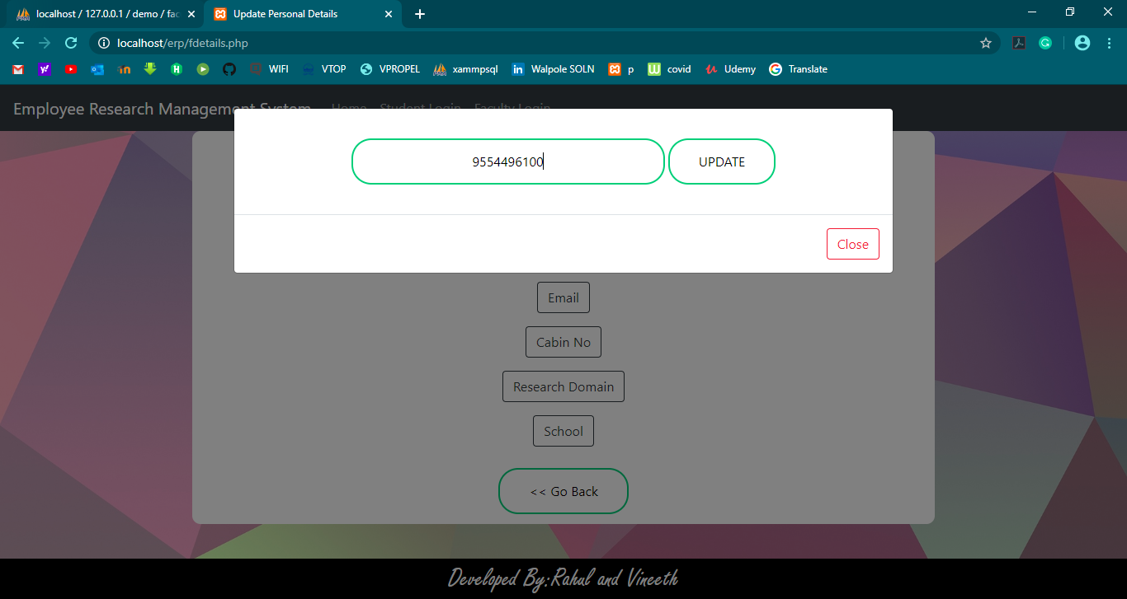
FACULTY PORTAL-Update Personal Details Page

Slide 23
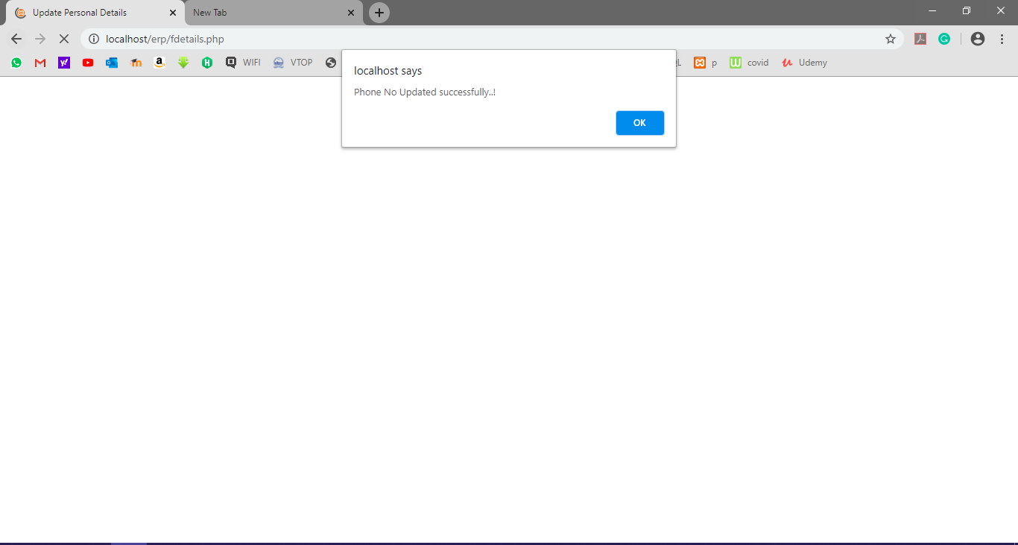
FACULTY PORTAL-Update Personal Details Page

Slide 24
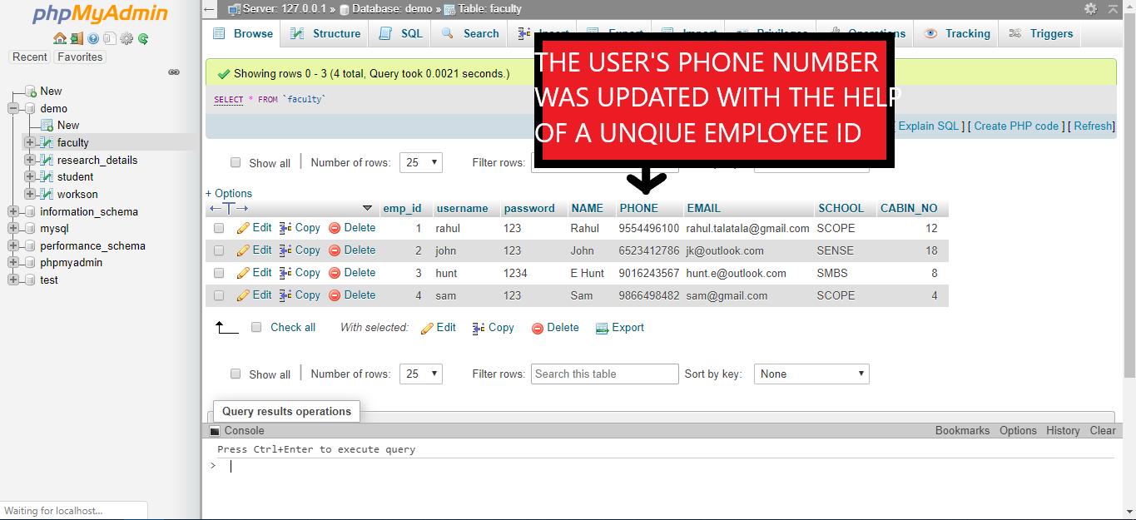
FACULTY PORTAL-Update Personal Details Page(Validation)

Slide 25
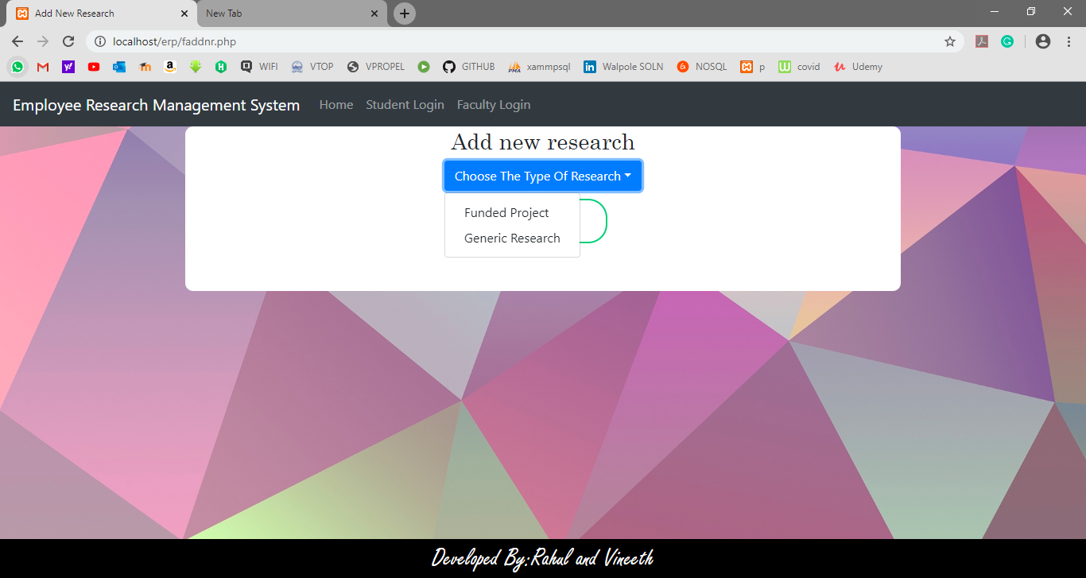
FACULTY PORTAL-Add New Research Page

Slide 26
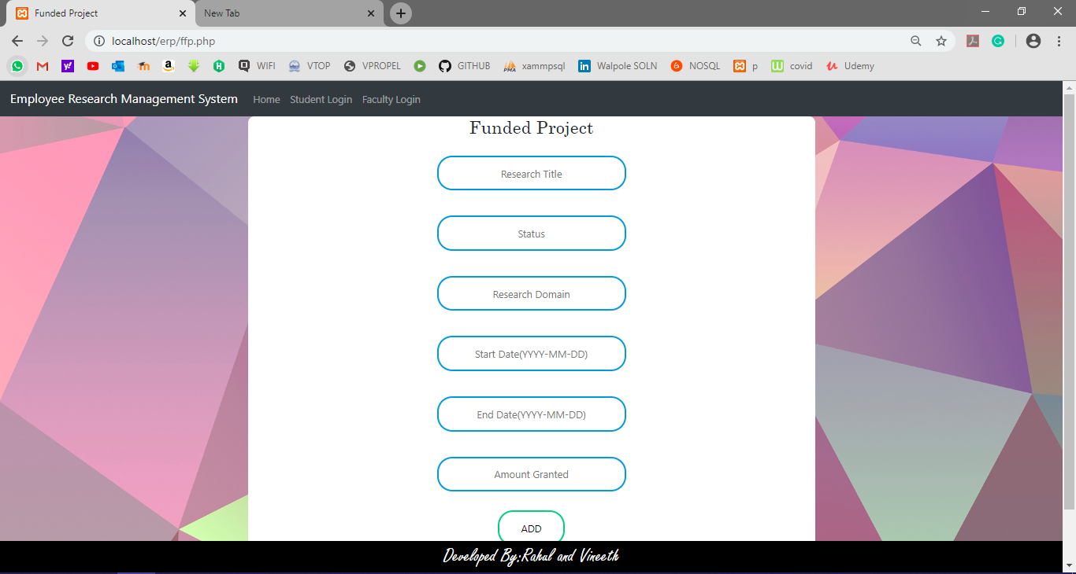
FACULTY PORTAL-Add New Research Page(Funded Project)

Slide 27
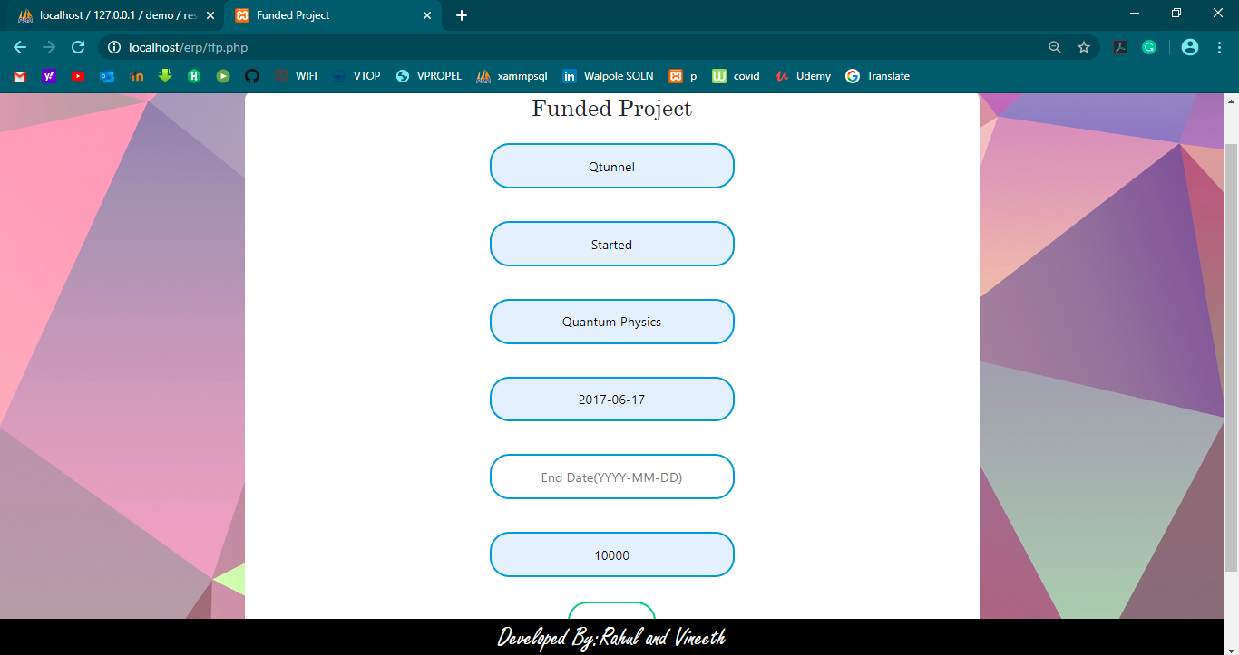
FACULTY PORTAL-Add New Research Page(Funded Project)

Slide 28
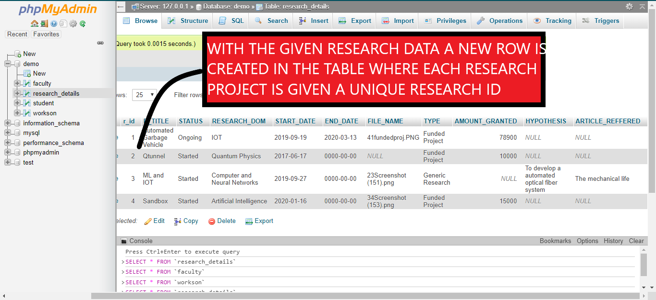
FACULTY PORTAL-Add New Research Page(Funded Project) VALIDATION IN RESEARCH_DETAILS TABLE

Slide 29
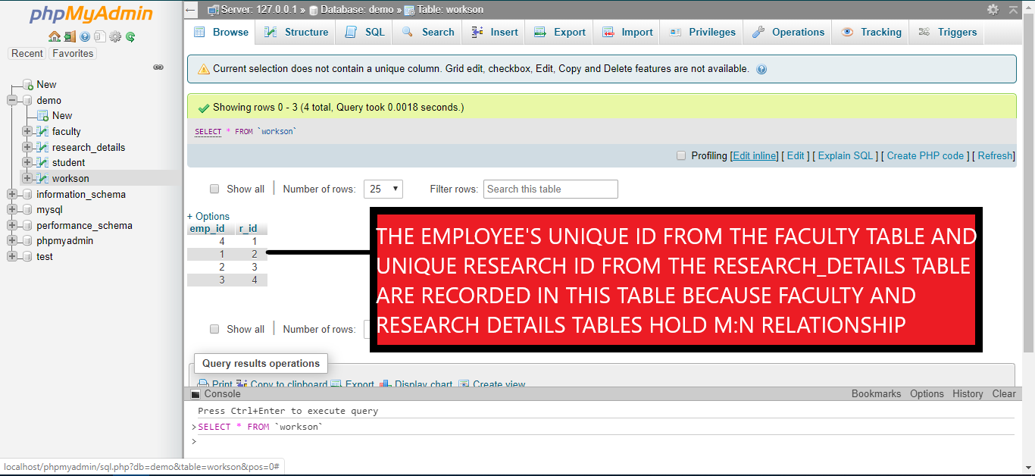
FACULTY PORTAL-Add New Research Page(Funded Project) VALIDATION IN WORKSON TABLE

Slide 30
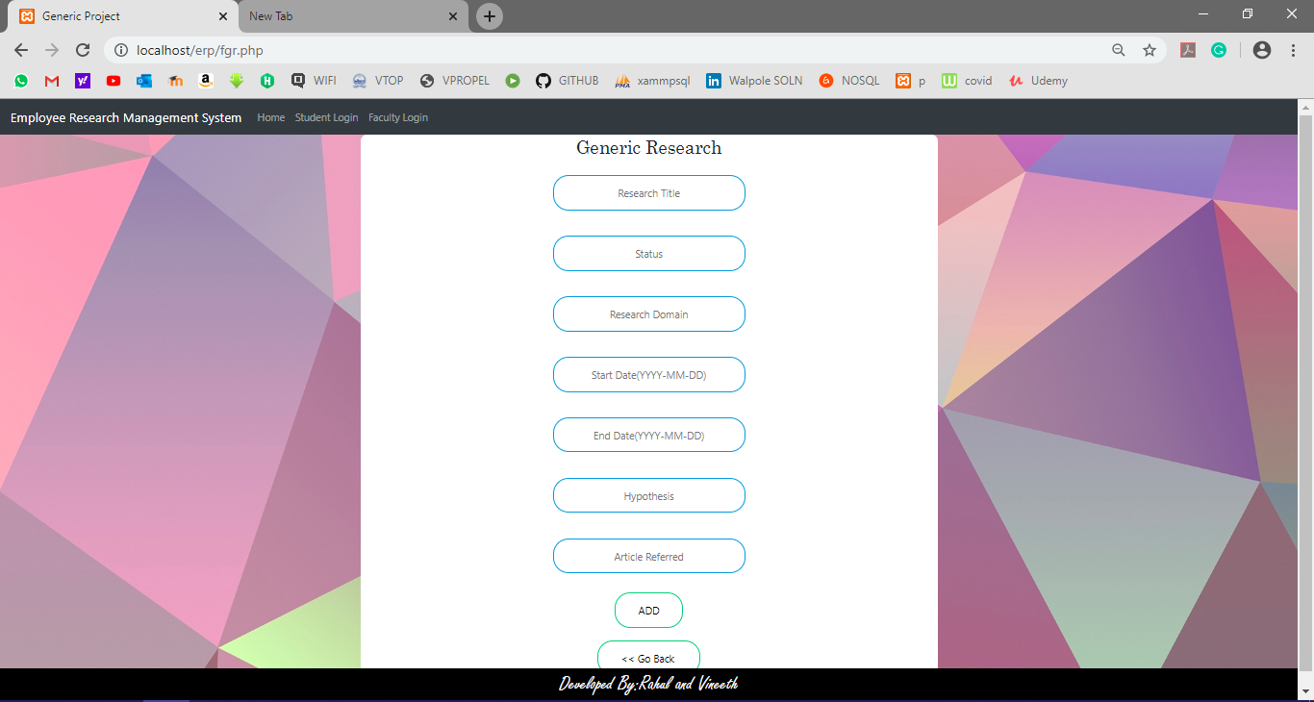
FACULTY PORTAL-Add New Research Page(Generic Research)

Slide 31
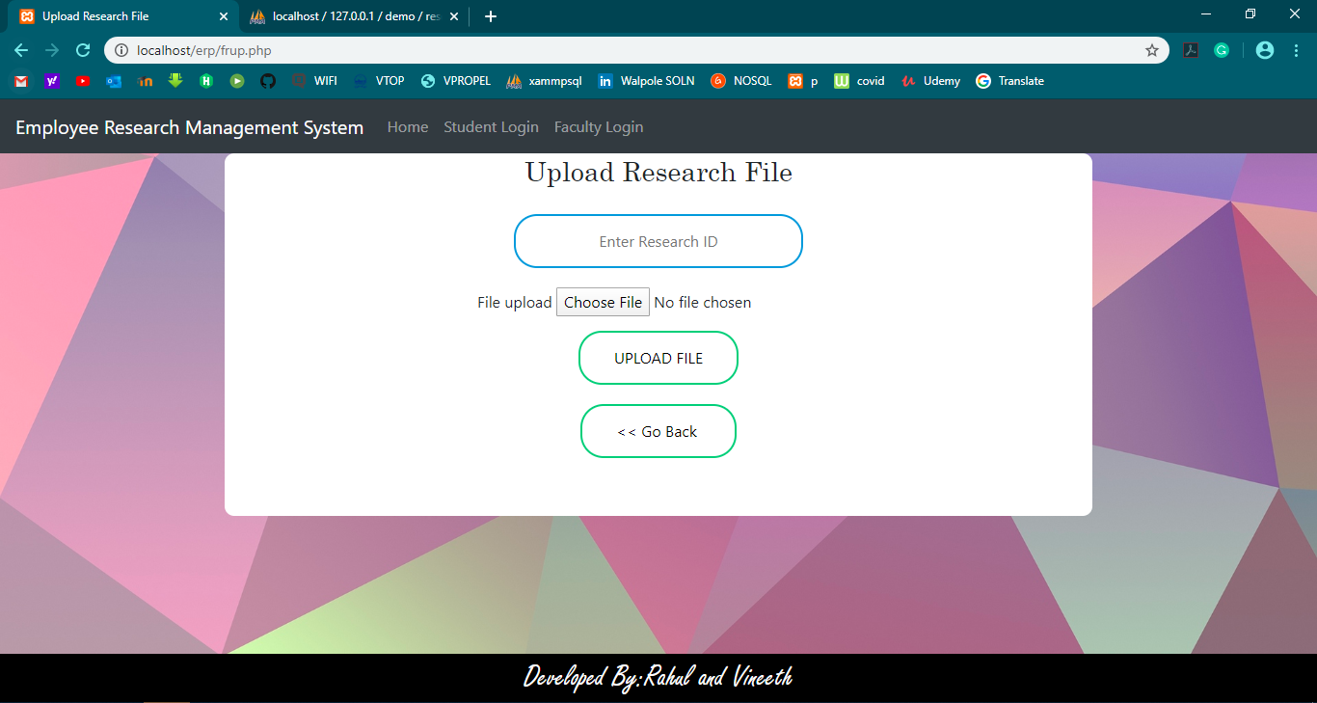
FACULTY PORTAL- Upload Research File

Slide 32
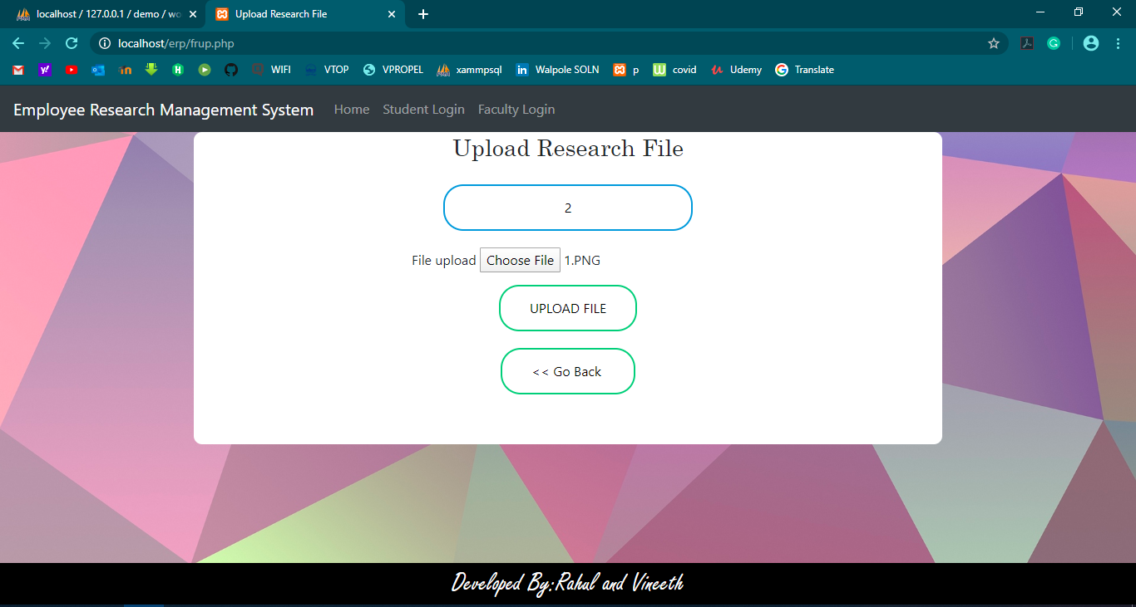
FACULTY PORTAL- Upload Research File

Slide 33
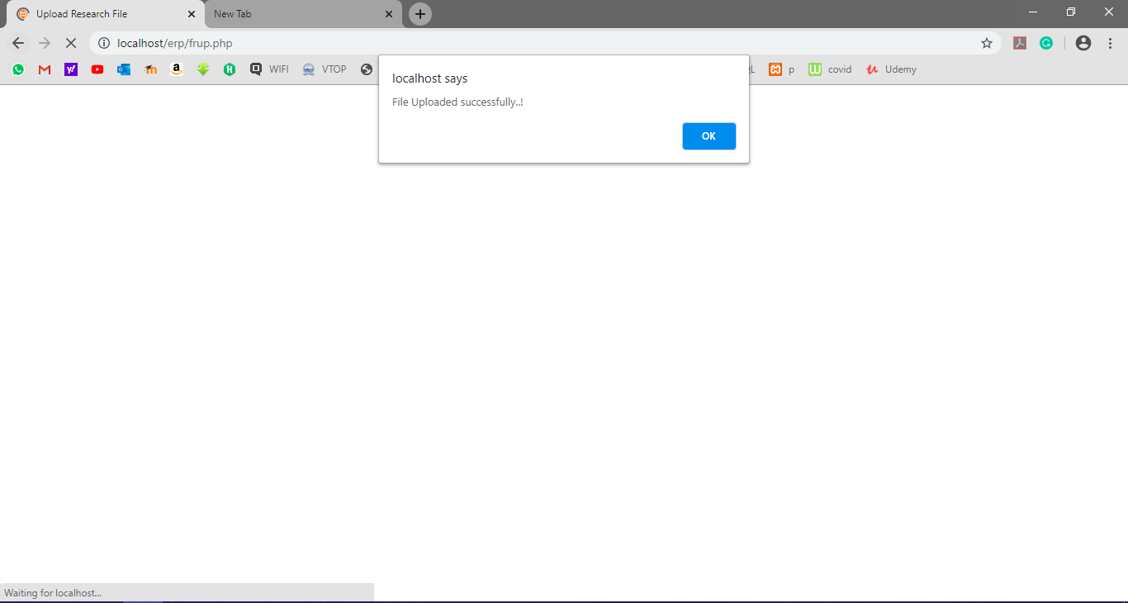
FACULTY PORTAL- Upload Research File

Slide 34
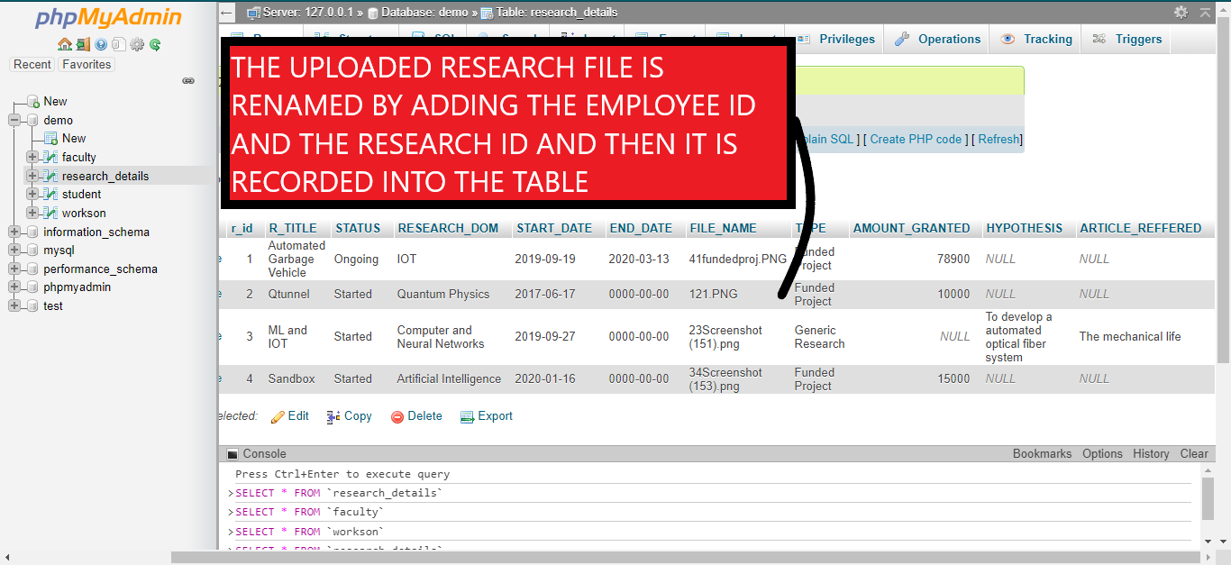
FACULTY PORTAL- Upload Research File Validation

Slide 35
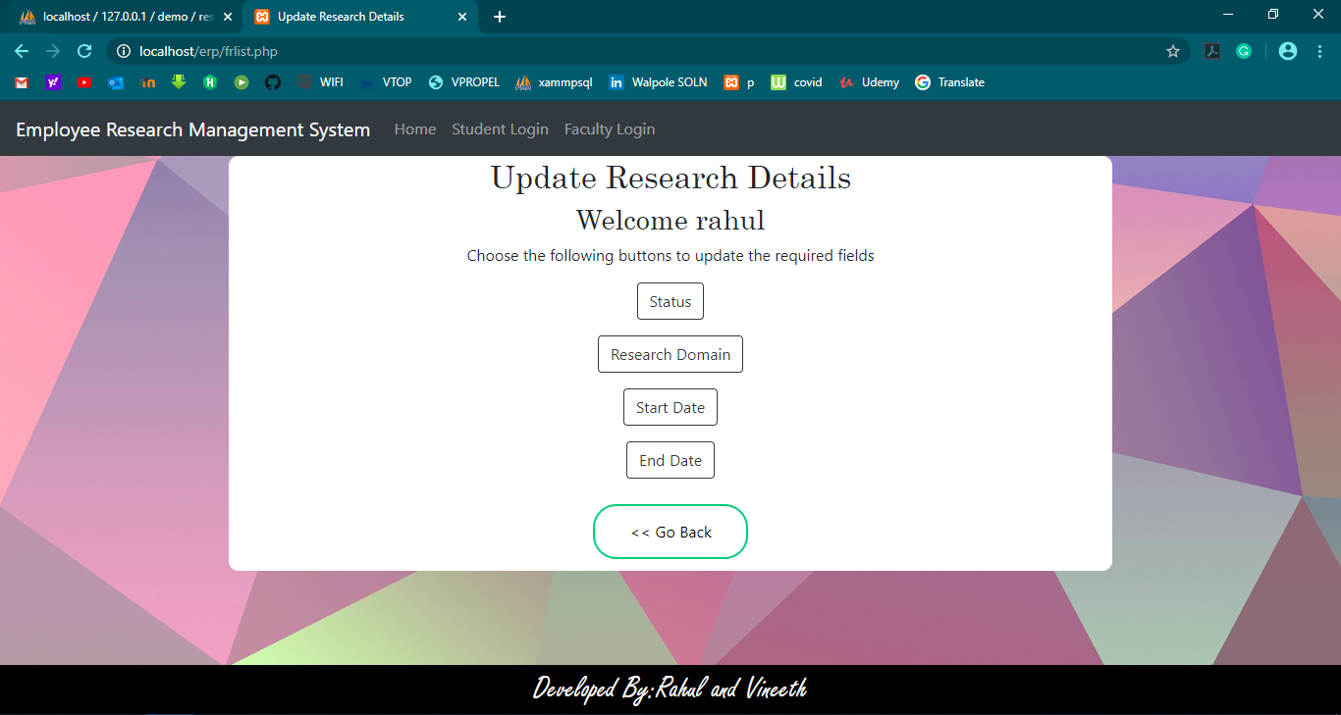
FACULTY PORTAL-Update Research Details

Slide 36
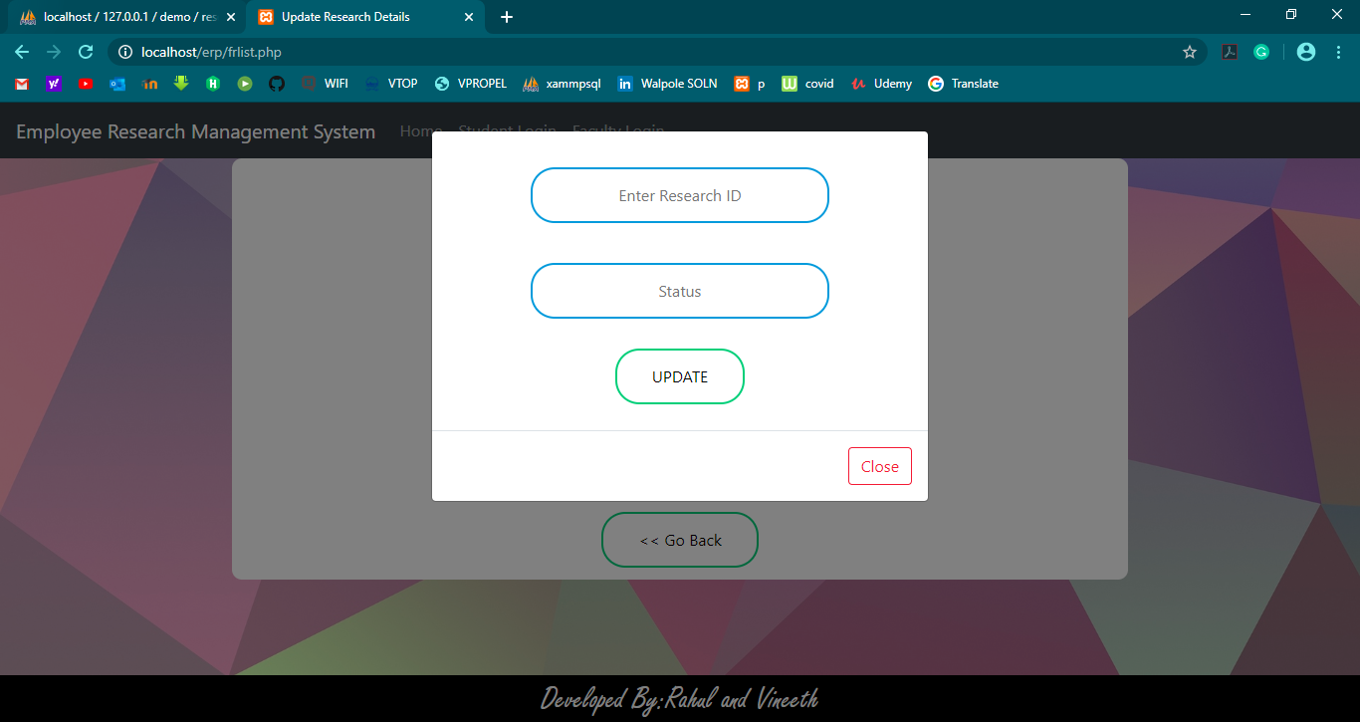
FACULTY PORTAL-Update Research Details

Slide 37
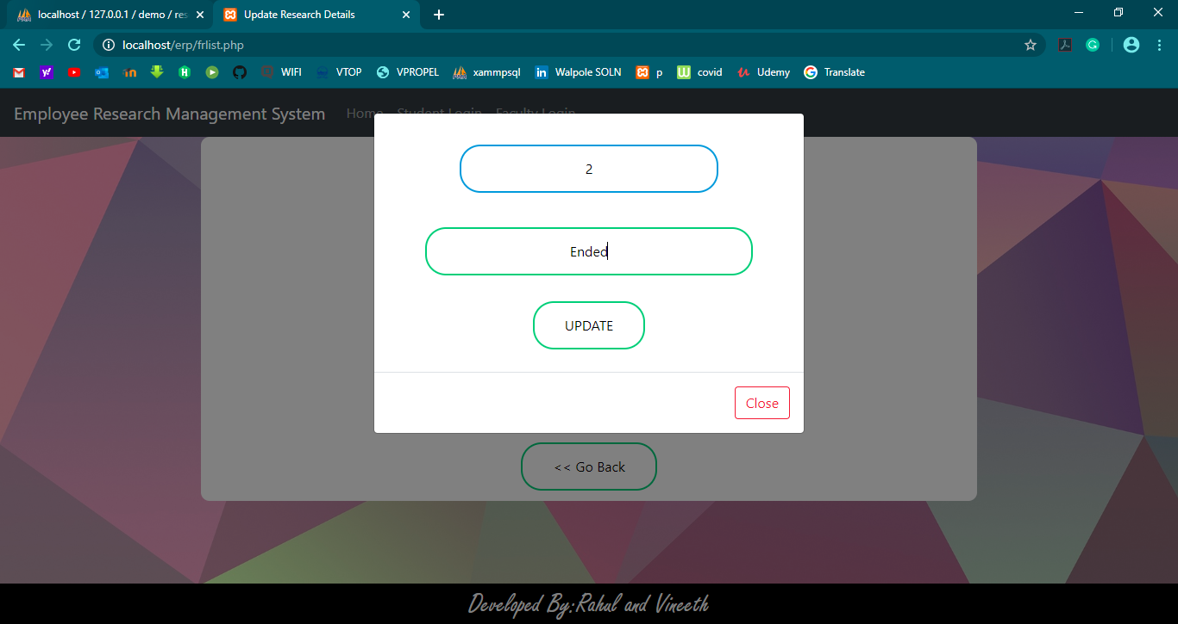
FACULTY PORTAL-Update Research Details

Slide 38
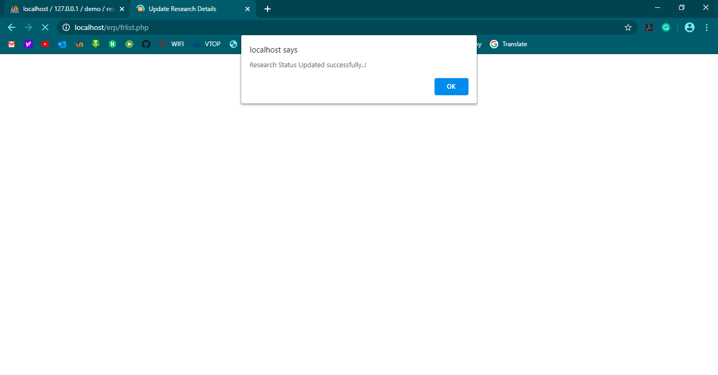
FACULTY PORTAL-Update Research Details

Slide 39
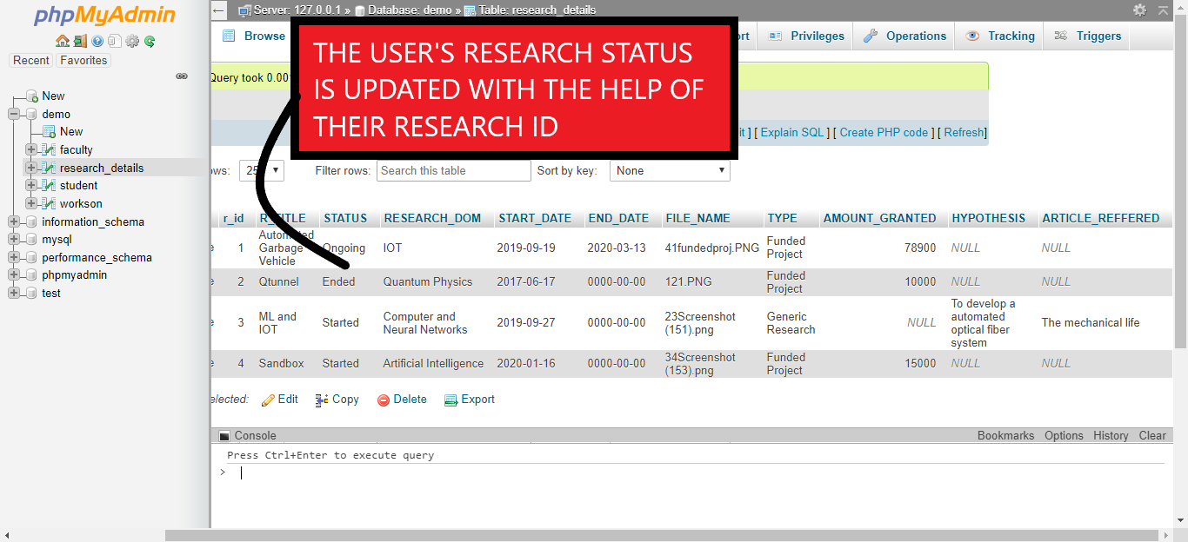
FACULTY PORTAL- Update Research Details Validation

Slide 40
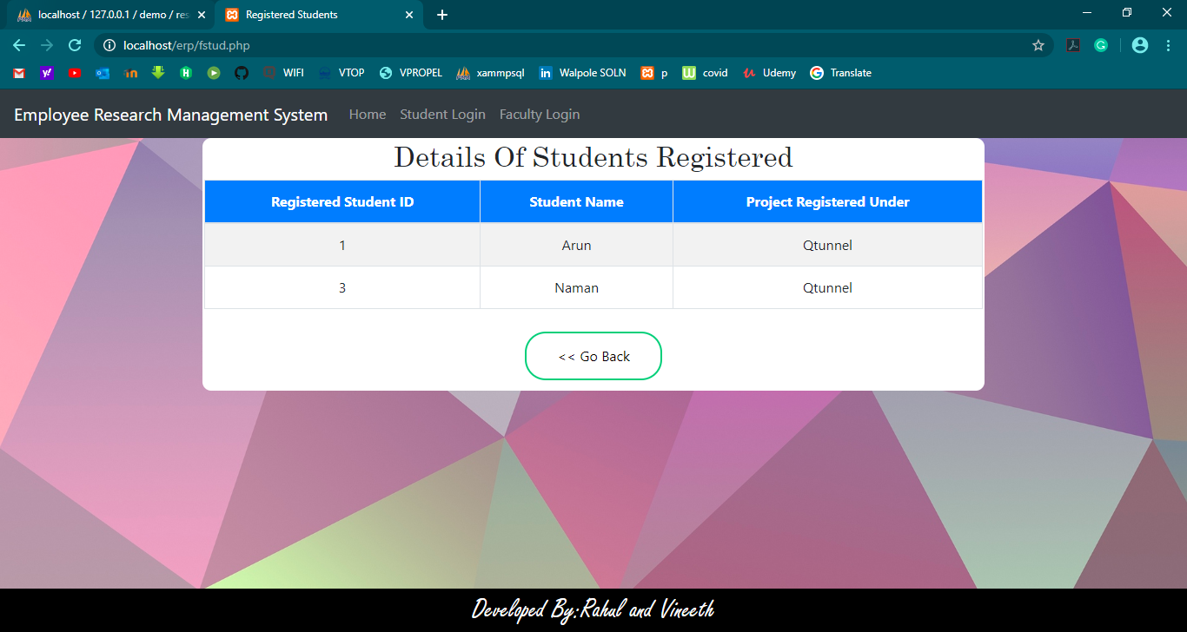
FACULTY PORTAL- Displaying Details Of Students Registered

Slide 41
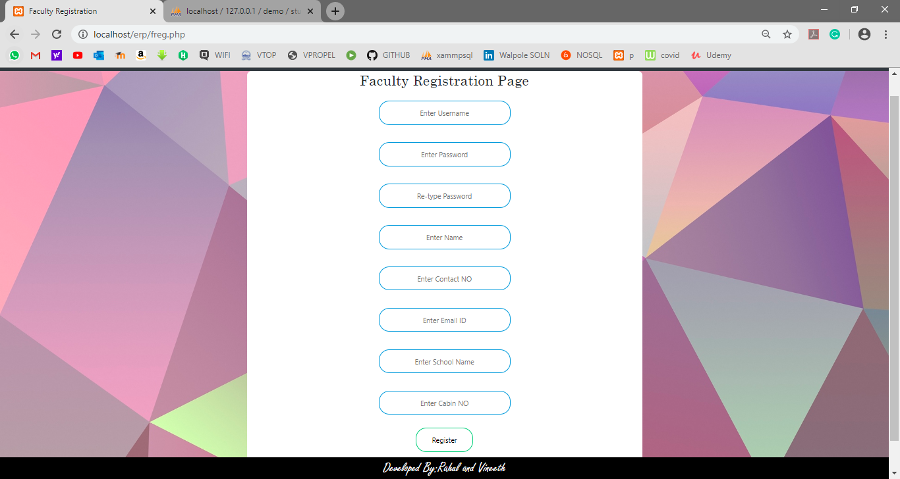
FACULTY PORTAL- Registration Page

Slide 42
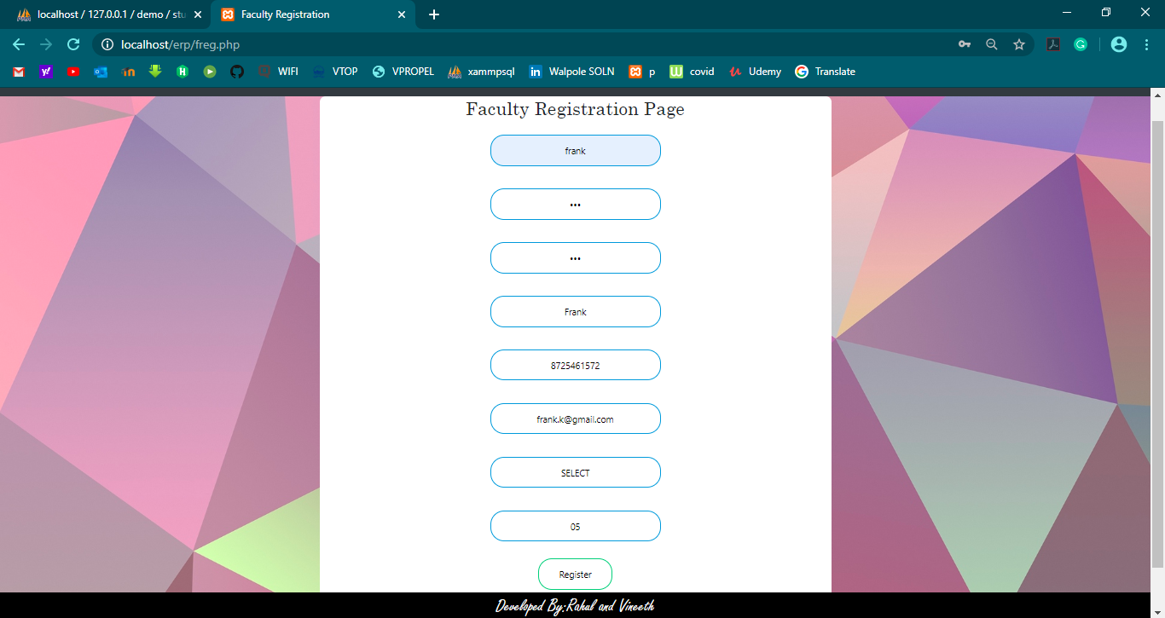
FACULTY PORTAL- Registration Page

Slide 43
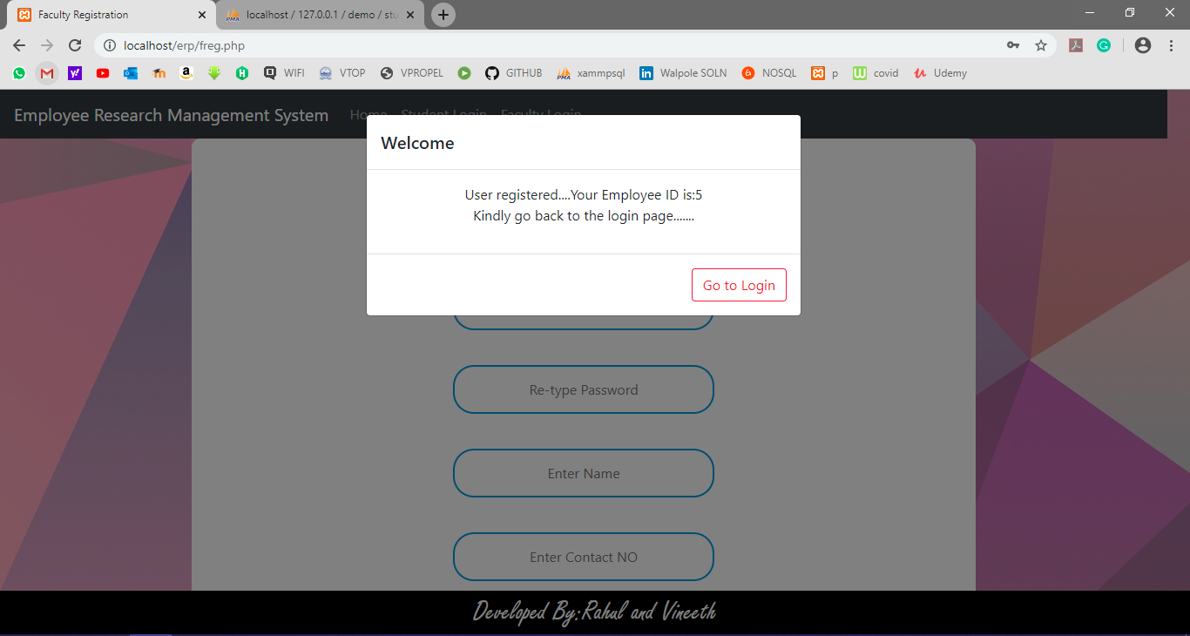
FACULTY PORTAL- Registration Page

Slide 44
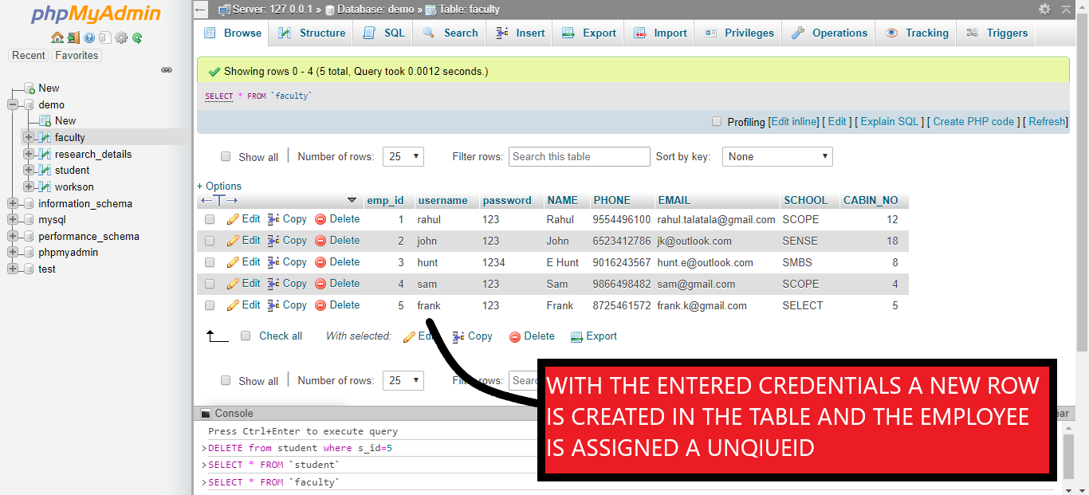
FACULTY PORTAL- Registration Page Validation

Slide 45
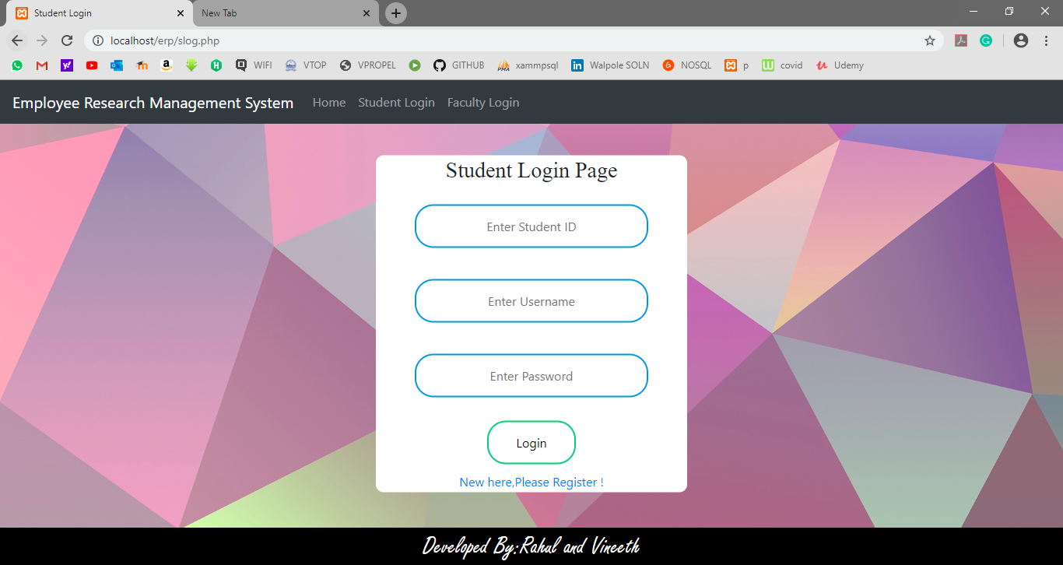
STUDENT PORTAL-Login Page

Slide 46
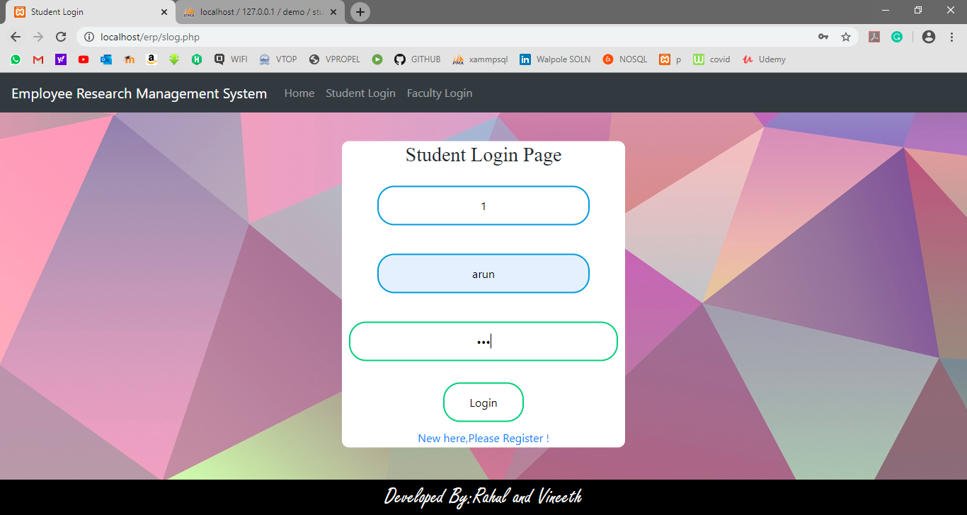
STUDENT PORTAL-Login Page

Slide 47
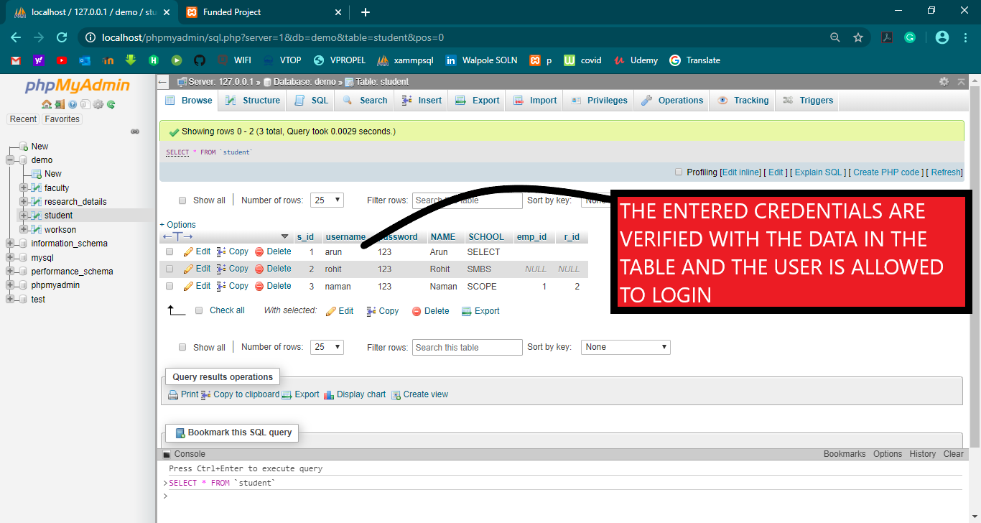
STUDENT PORTAL-Login Page Validation

Slide 48
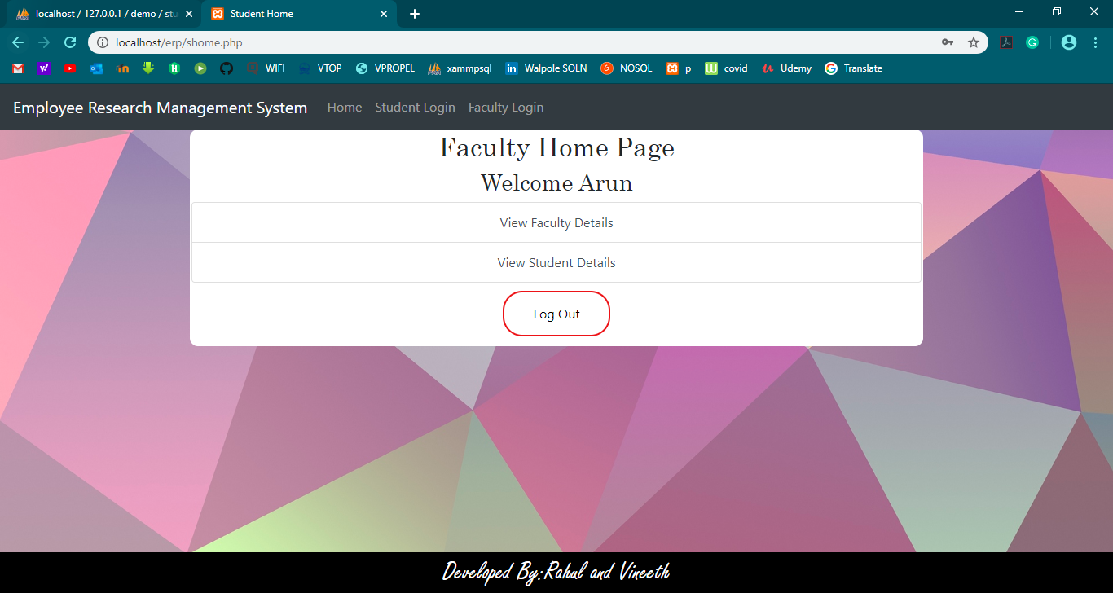
STUDENT PORTAL-Home Page

Slide 49
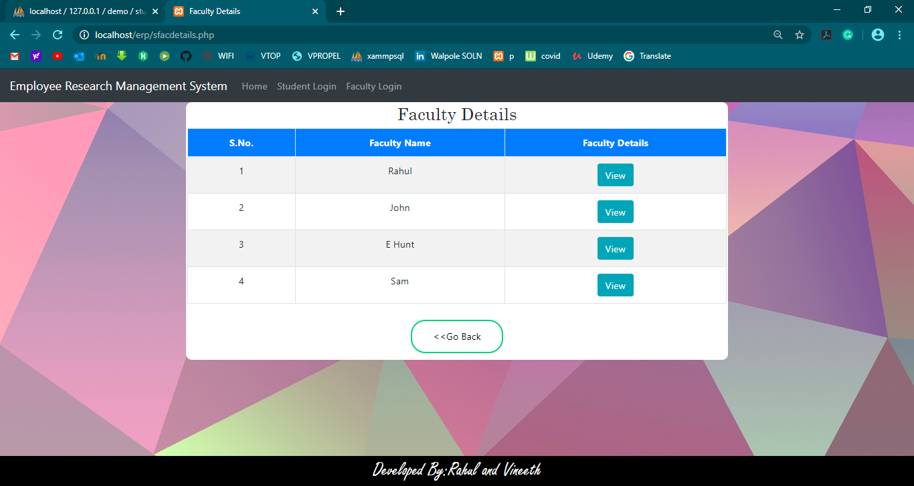
STUDENT PORTAL-Faculty Details Page

Slide 50
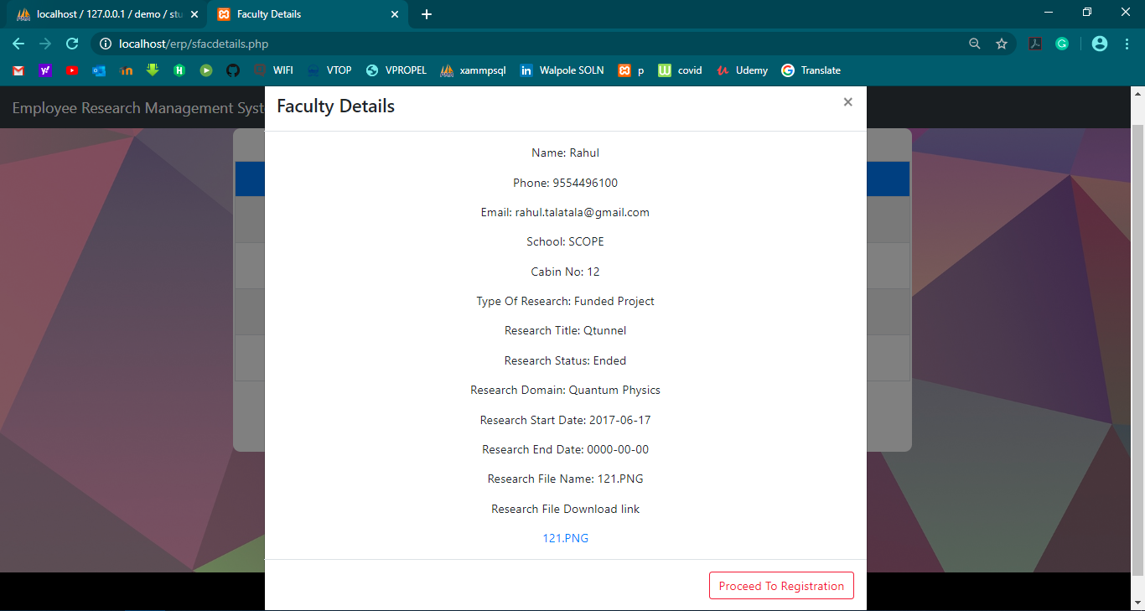
STUDENT PORTAL-Faculty Details Page

Slide 51
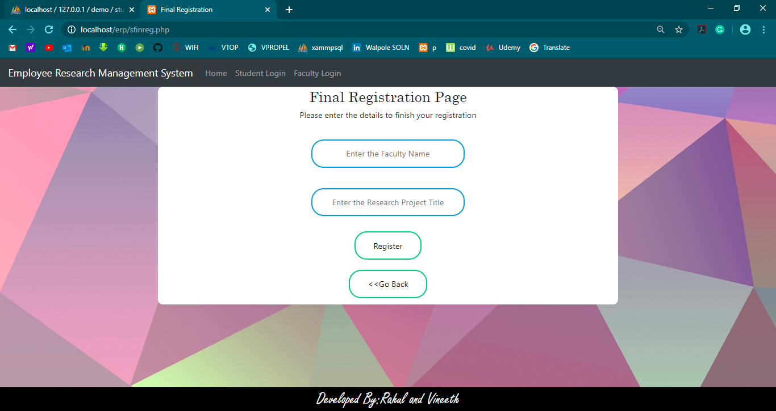
STUDENT PORTAL-Registration Under a Faculty

Slide 52
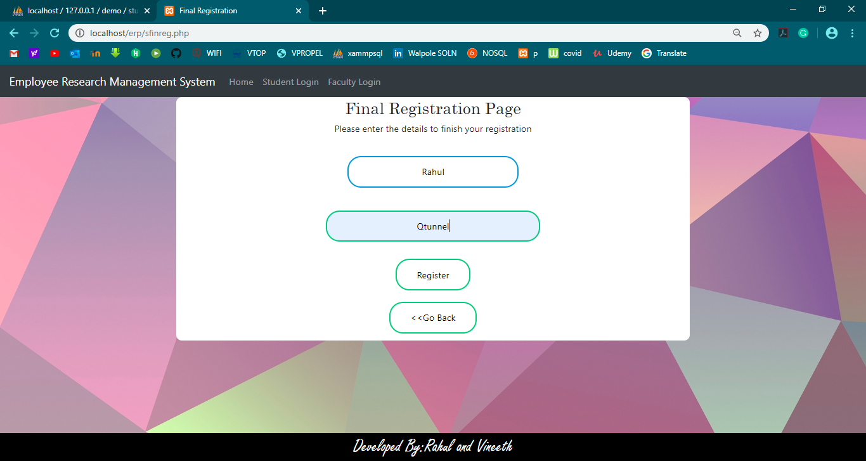
STUDENT PORTAL-Registration Under a Faculty

Slide 53
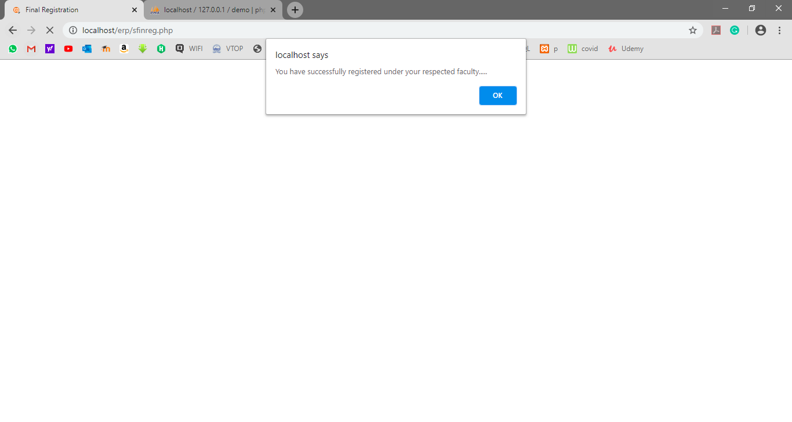
STUDENT PORTAL-Registration Under a Faculty

Slide 54
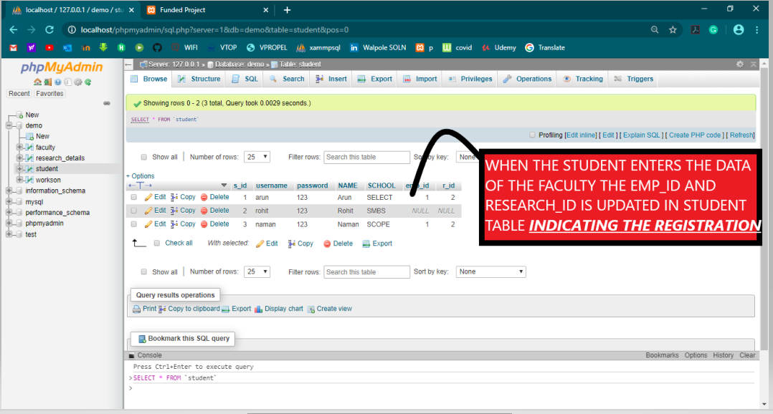
STUDENT PORTAL-Registration Under a Faculty(Validation)

Slide 55

STUDENT PORTAL-Displaying Personal Details

Slide 56

STUDENT PORTAL-Trying to register under another faculty

Slide 57
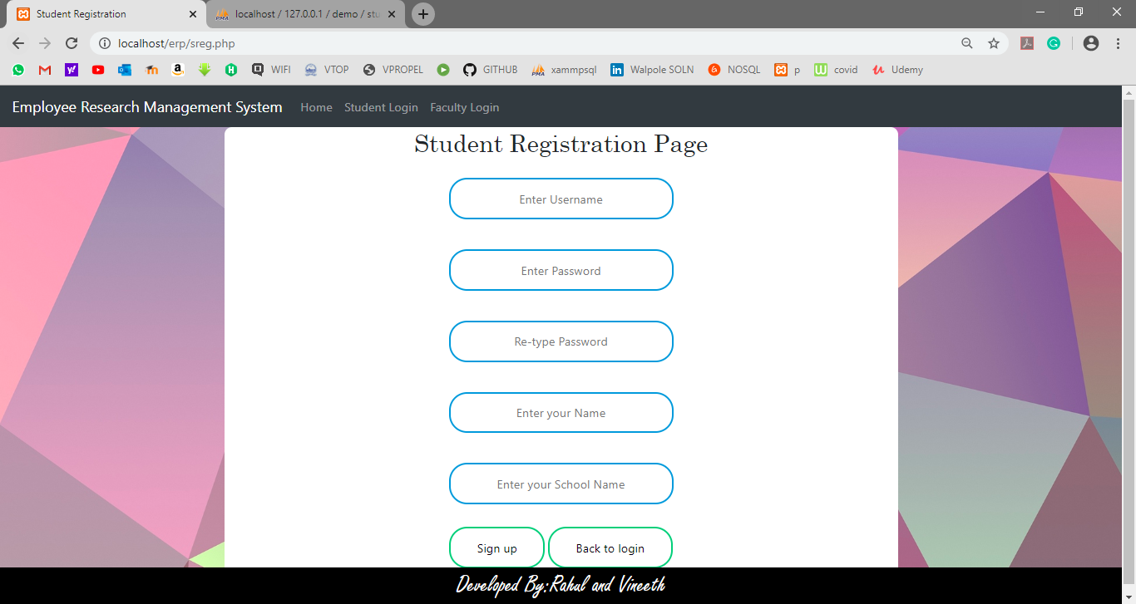
STUDENT PORTAL-Registration Page

Slide 58
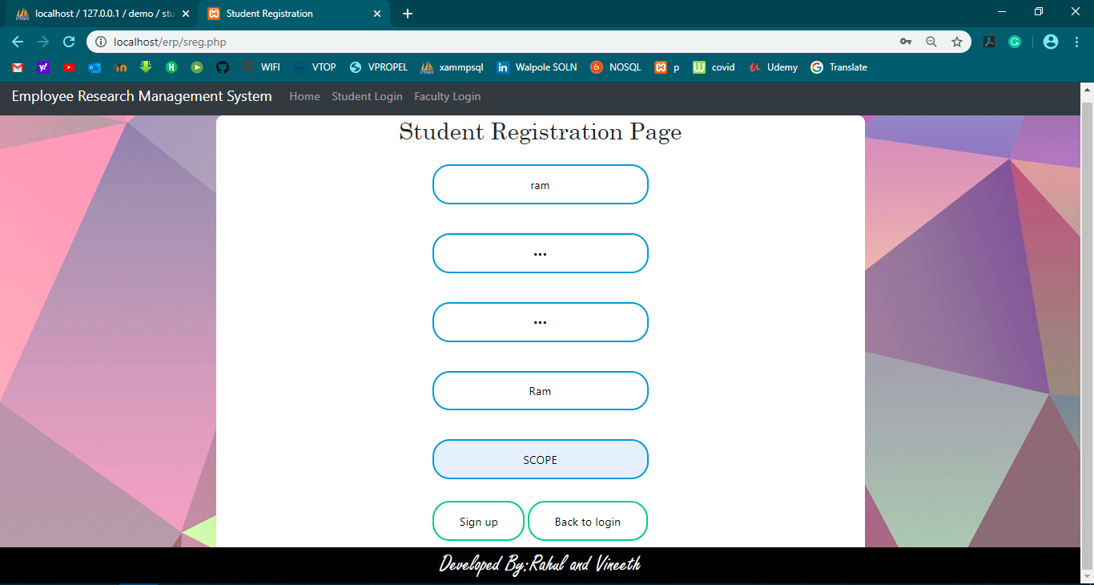
STUDENT PORTAL-Registration Page

Slide 59
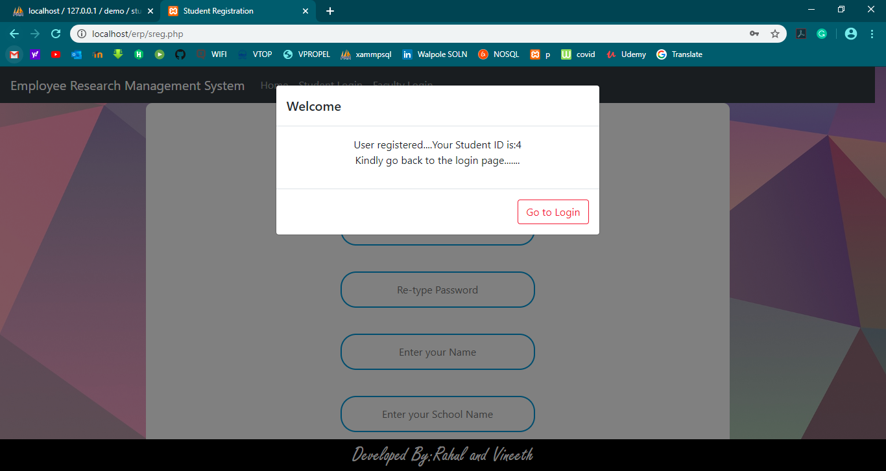
STUDENT PORTAL-Registration Page

Slide 60
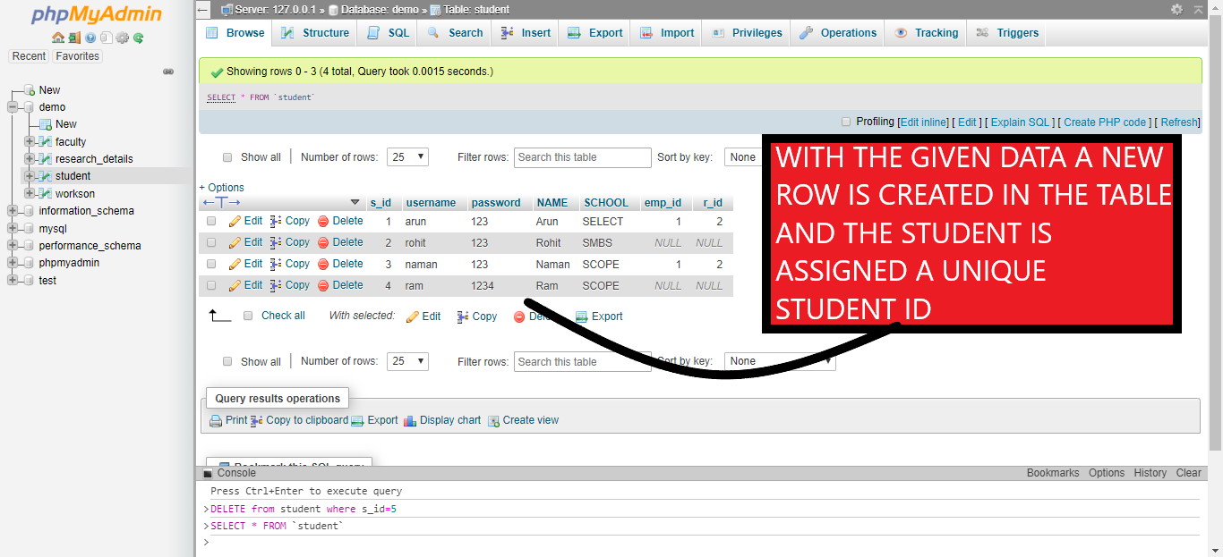
STUDENT PORTAL-Registration Page Validation

Slide 61
DATABASE CONNECTIVITY STEPS
Open the XAMPP Control Panel
Start the Apache and MySQL modules
Click on the Admin button to launch phpMyAdmin and create a new database
Create a folder in C:\xampp\htdocs
Create a Database Connection File in PHP and save it in the folder that you have created
Run the file by typing the address of the file in the address bar of your browser

Slide 62
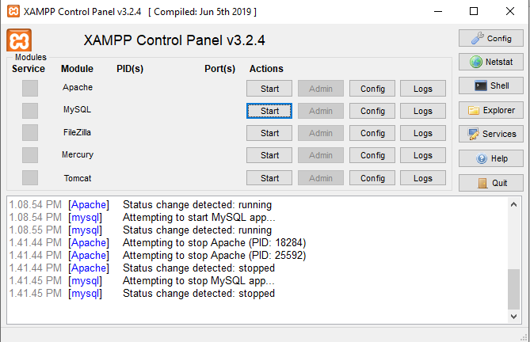
Step 1: Open the XAMPP Control Panel

Slide 63
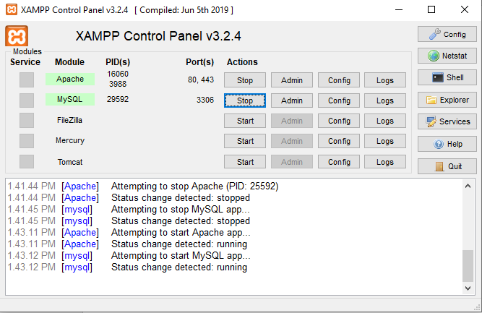
Step 2: Start the Apache and MySQL modules

Slide 64

Step 3: Click on the Admin button next to MySQL module to launch phpMyAdmin and create a new database

Slide 65

Step 3: Click on the Admin button next to MySQL module to launch phpMyAdmin and create a new database

Slide 66

Step 4: Create a folder in C:\xampp\htdocs

Slide 67

Step 5: Create a Database Connection File in PHP and save it in the folder that you have created
If the connection to the database is successful then it will display the following message else, It would display an error why it could not connect to the database.
In the above code:-
User-root
Password-none
Database Name-demo

Slide 68

Step 6:Run the file by typing the address of the file in the address bar of your browser

Slide 69
CHALLENGES
Creating a download option for the project was a challenge we faced while doing this project.
The manual entry for the registration under a new faculty in the students portal was certainly an issue we faced.
Making sure that a student can only register under one faculty

Slide 70
CONCLUSION
The employee research management system is design for saving money, time and power and work well for the faculty and the students. For improving effectiveness of workplace management, an employee research management system is implemented. This is very useful for the final year students in carrying out their capsule project and ensures the smooth communication between the faculty and the student.

